Slide 1
Precise Analysis

Slide 2
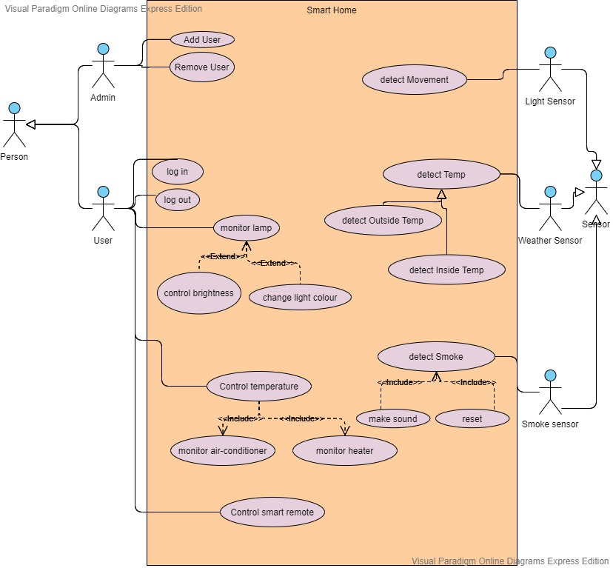
USE CASE DIAGRAM

Slide 3
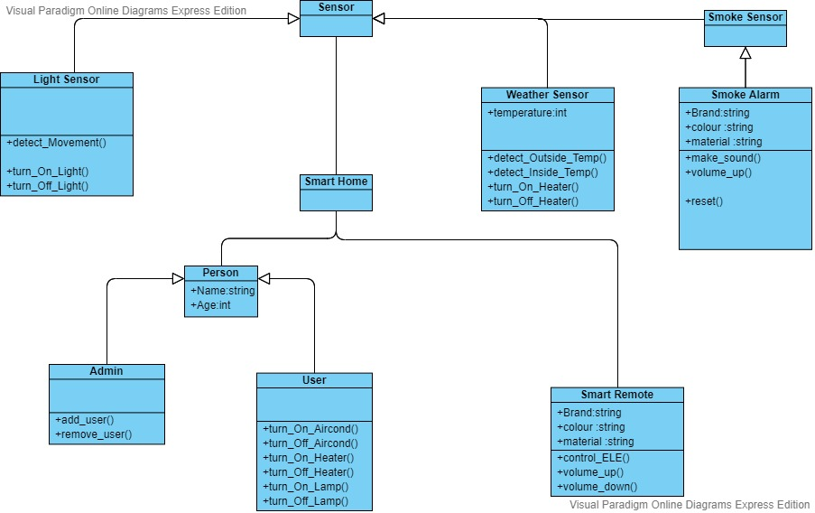
Main Class Diagram For Smart Home System

Slide 4
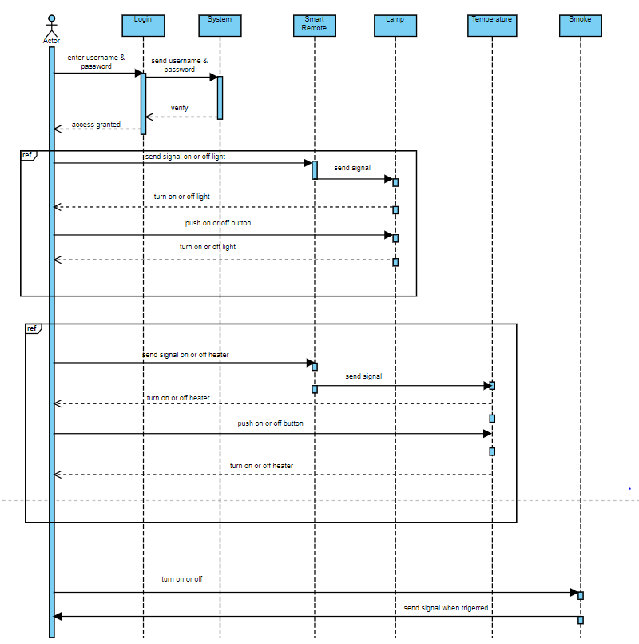
SEQEUNCE DIAGRAM FOR SMART REMOTE

Slide 5
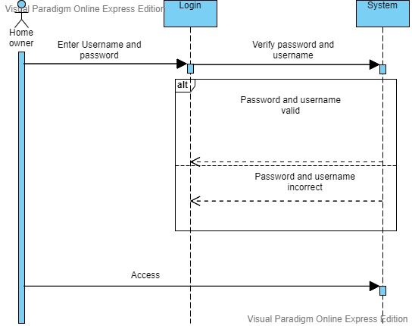
SEQUENCE DIAGRAM FOR LOGIN

Slide 6
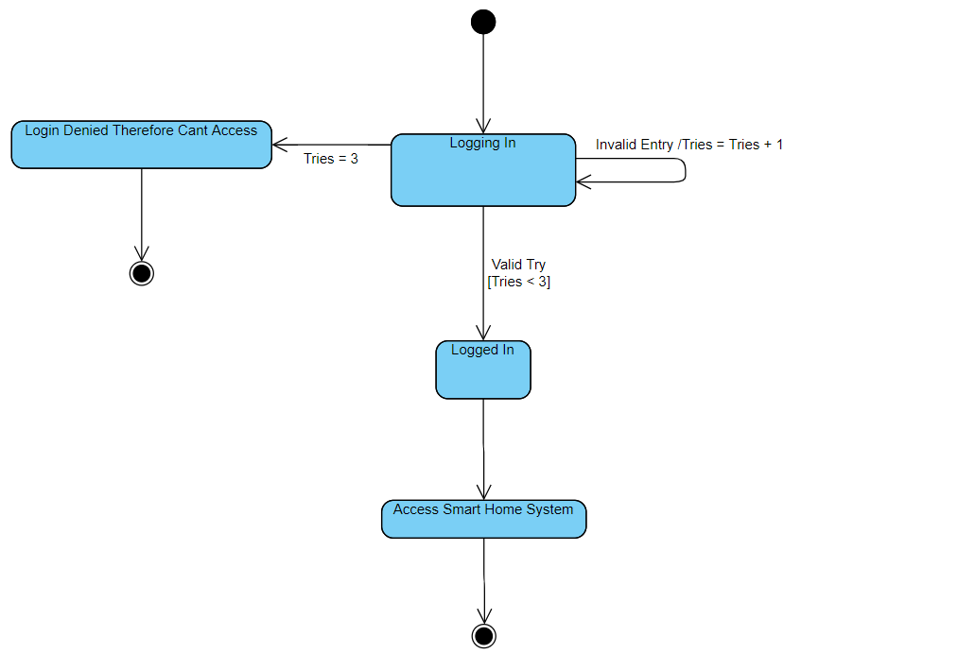
State Diagram For Smart Home Login System

Slide 7
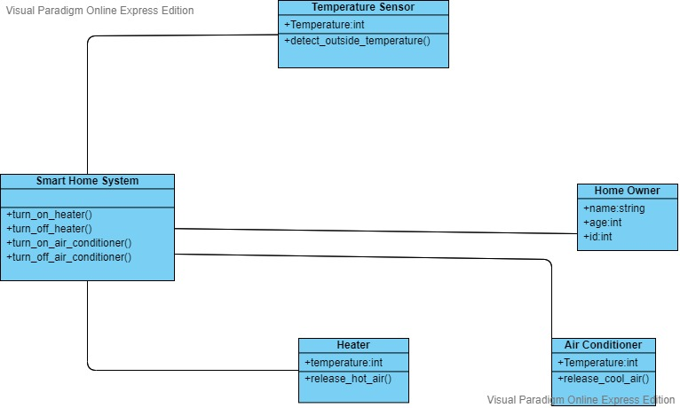
Class Diagram for Heating And Cooling

Slide 8
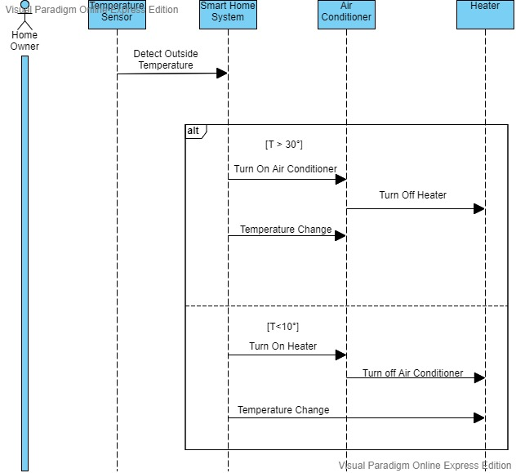
Sequence Diagram for Heating And Cooling

Slide 9
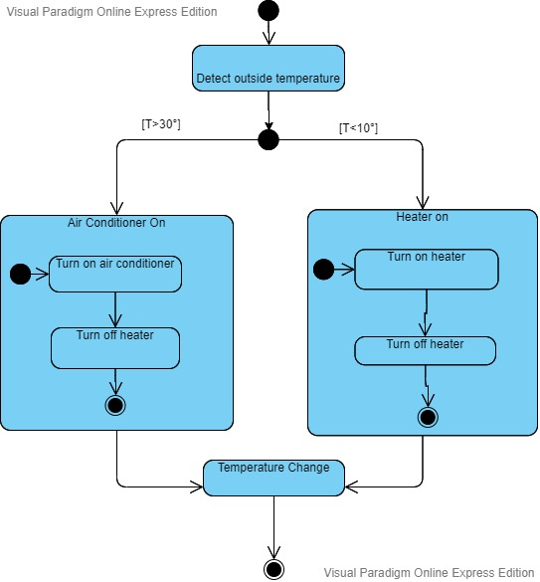
State Diagram for Heating And Cooling

Slide 10
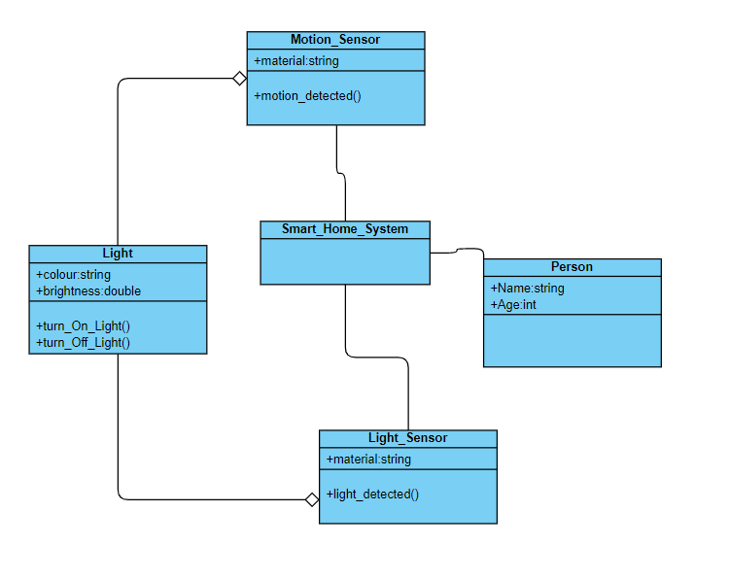
CLASS DIAGRAM FOR LIGHT CONTROLLING INITIATE BY SENSOR

Slide 11
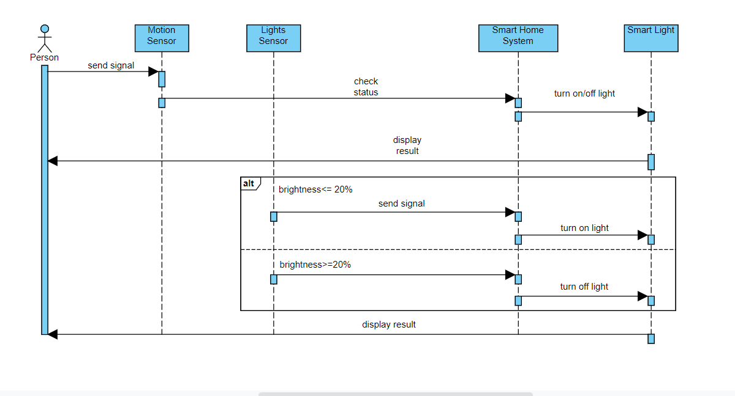
SEQUENCE DIAGRAM FOR LIGHT CONTROLLING INITIATE BY SENSOR

Slide 12
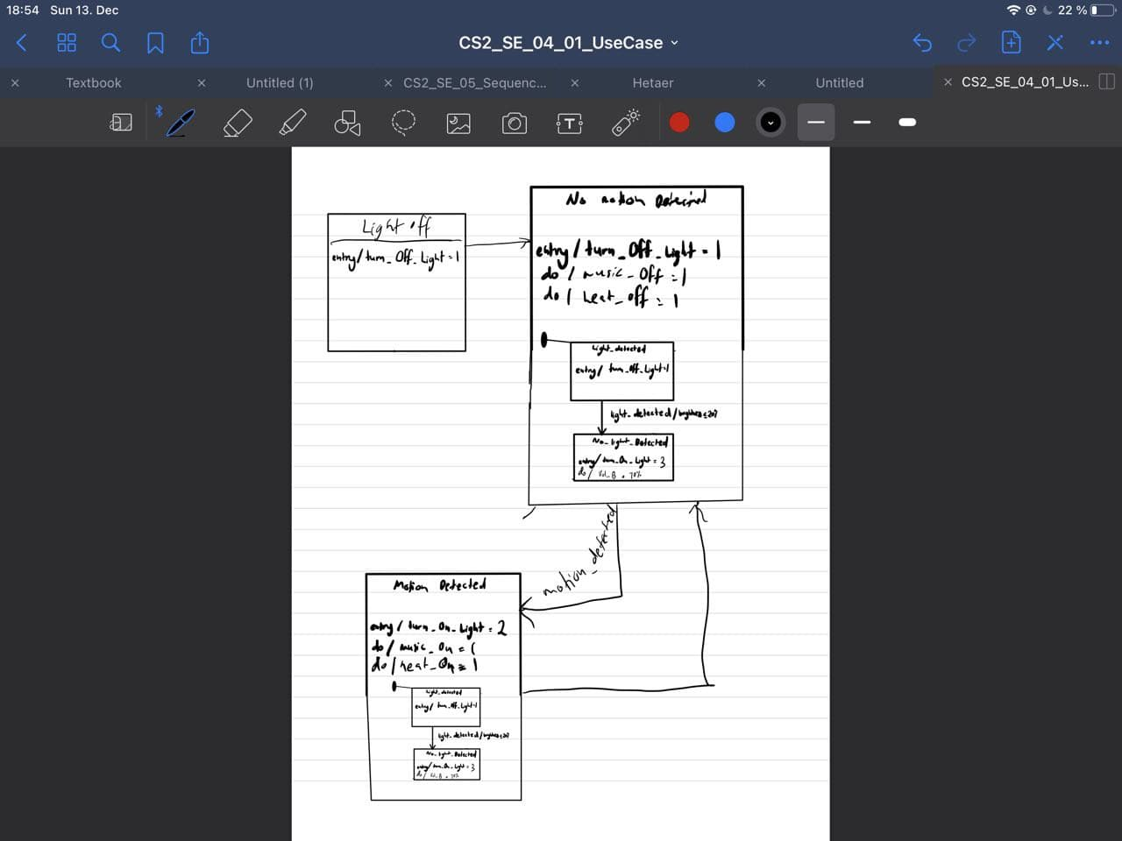
STATE DIAGRAM FOR LIGHT AND MOTION SENSOR

Slide 13
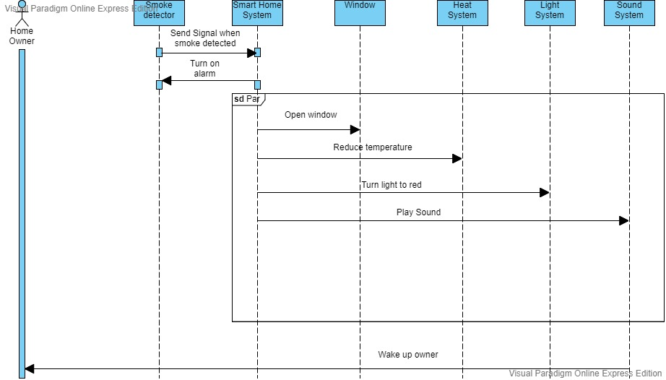
Sequence Diagram for Fire Alarm

Slide 14
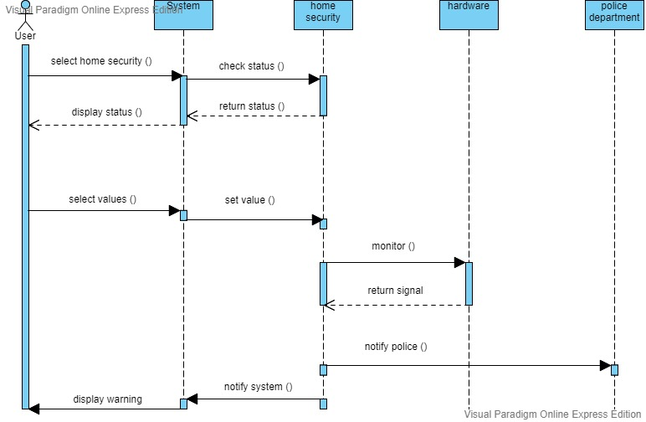
SEQUENCE DIAGRAM FOR SECURITY

Slide 15
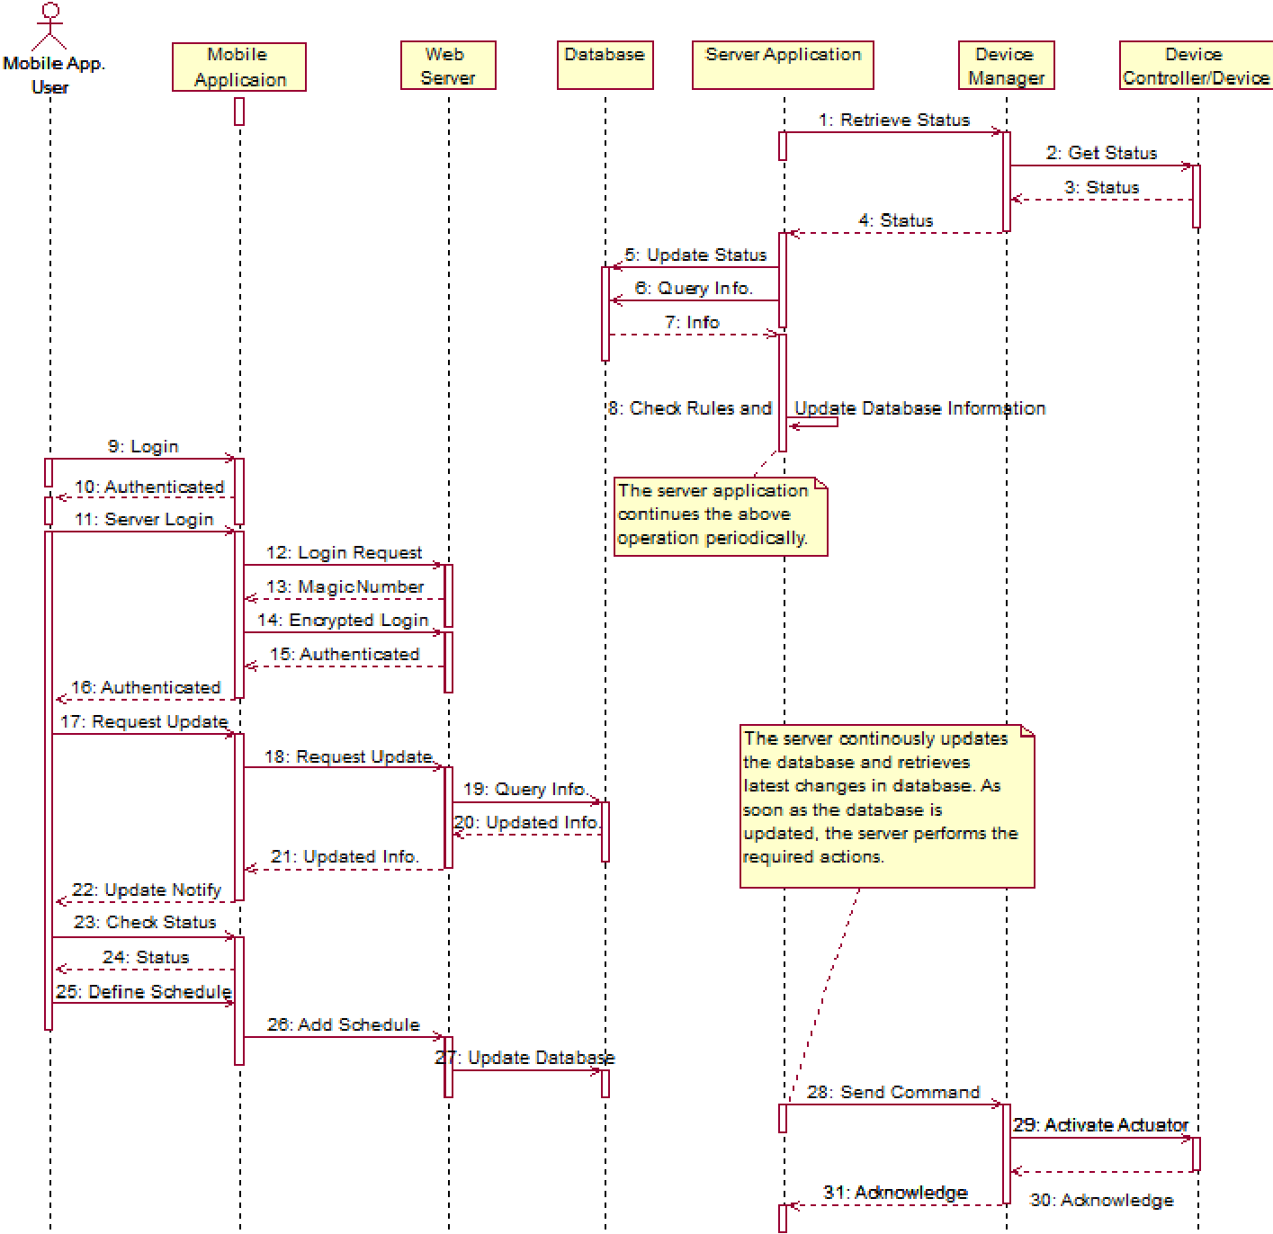
MORE GENERAL FORM

